Slide 1
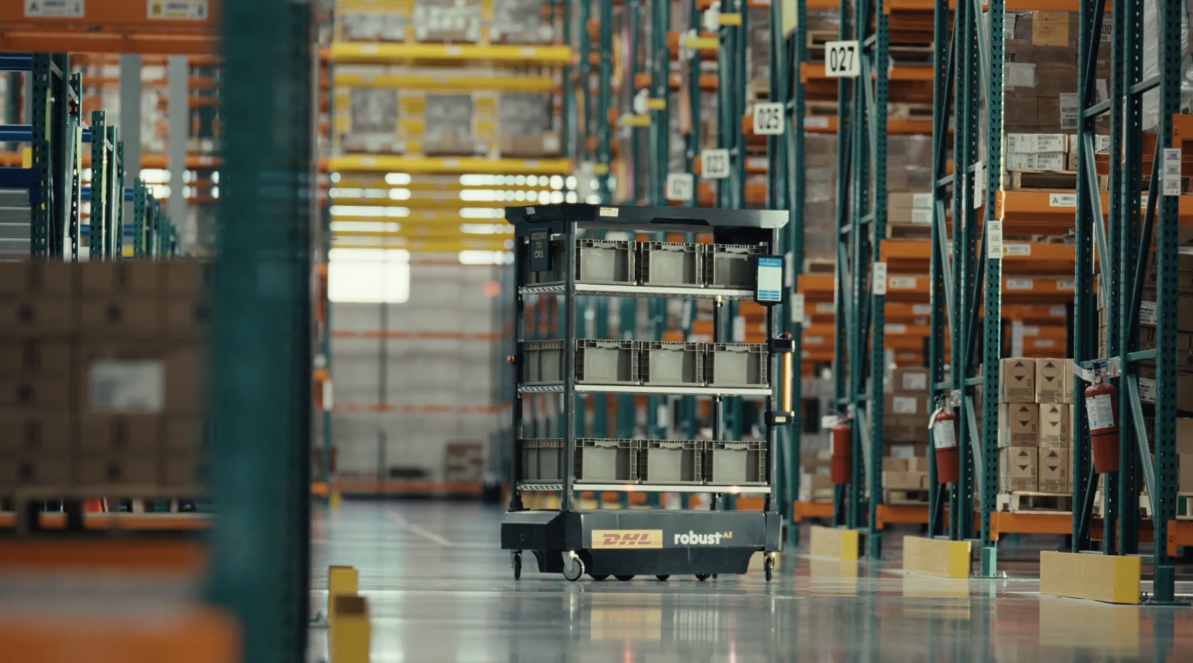


Robust01 Project Team

Slide 2
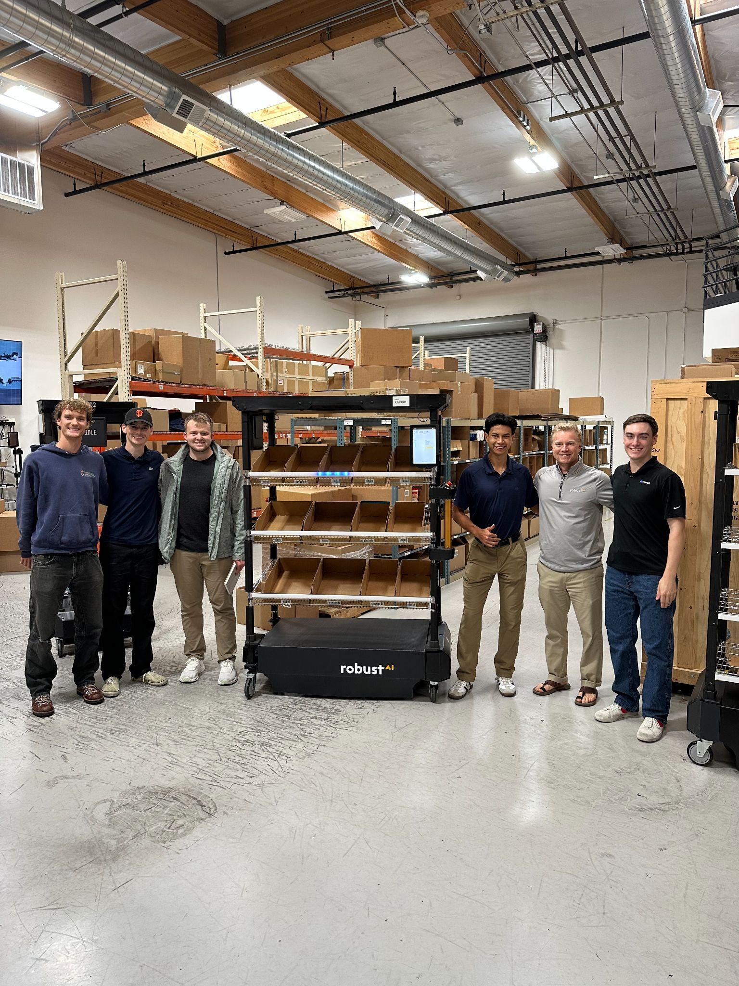
RobustAI Company Background
RobustAI focuses on innovating technologies of automated and semi-autonomous robots utilized for warehouse packing and shipping, with a proprietary Cognitive Engine that enables robots to operate safely and reliably alongside human workers by understanding and reacting to complex, dynamic environments.

Slide 3
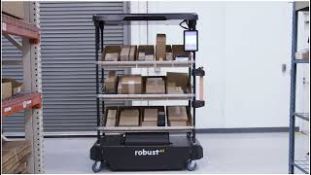

Slide 4
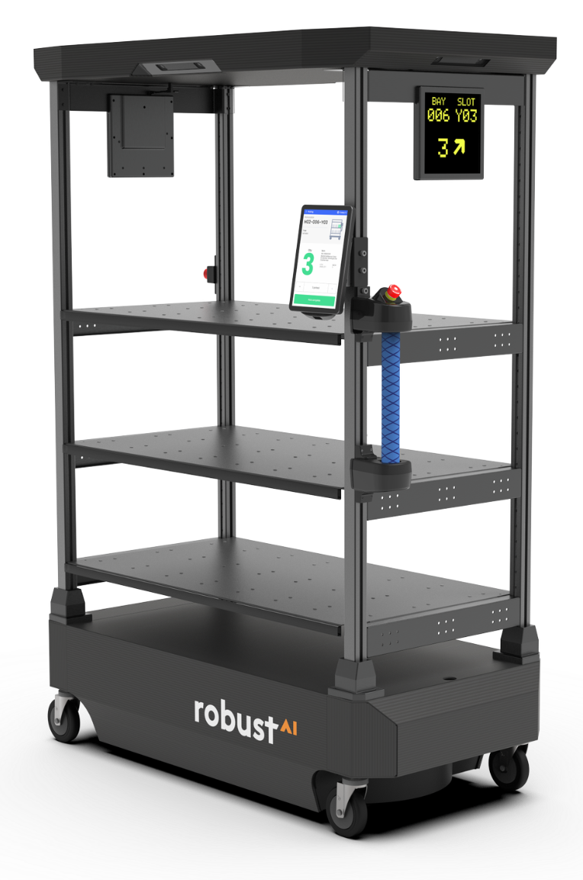
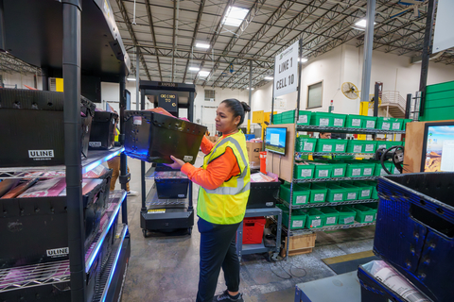
CARTER Robot
C.A.R.T.E.R. is a semi-autonomous robot used by customers of ROBUSTAI pertaining to warehouse operations. It contains shelves with light strips indicating loaded packages, marquees for displaying current action of the robot, as well as a screen displaying the specific package ID. It’s main contribution comes from the guided-reactive handle that allows workers to move the robot smoothly without carrying the entire weight of each cart.
C. Cognitive
A. Autonomous
R. Reliable
T. Throughput
E. Engine
R. Real-Time

Slide 5
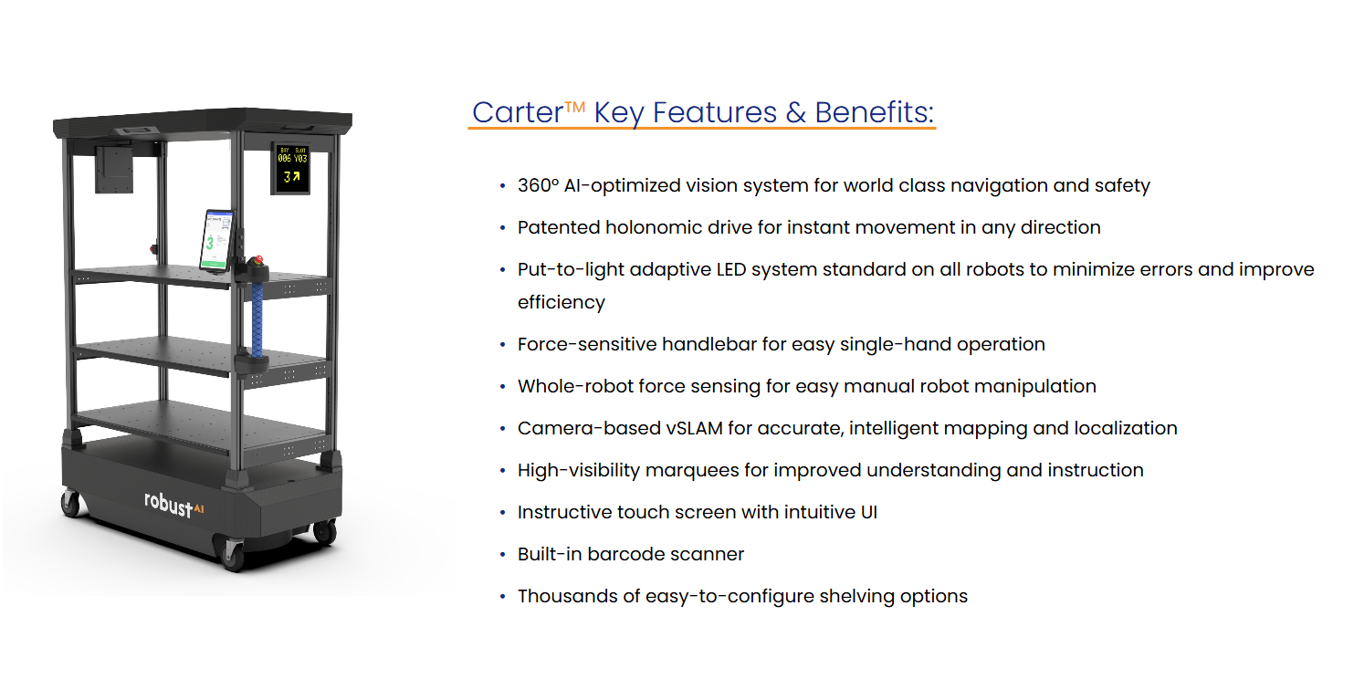

Slide 6
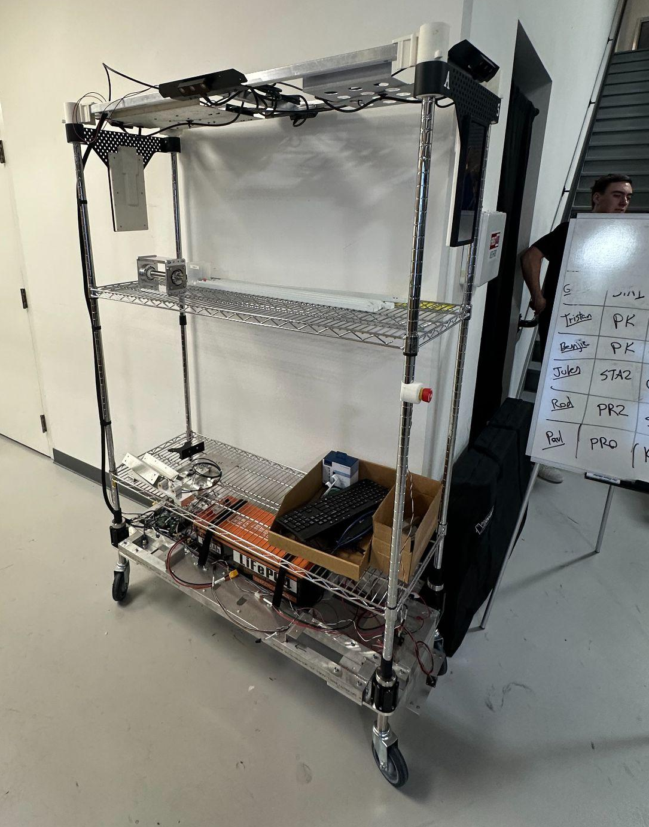
Problem Statement
Robust AI's manual tote exchange process for its variable robot fleet is a system bottleneck, averaging 10 seconds of task time per container handled, despite a target task time of 5 seconds.
This project is scoped exclusively to the load/unload workstation, decoupled from downstream packing, and aims to identify data-driven strategies to minimize robot idle time and furthermore minimize total operating costs.
To the right is the ORIGINAL Mach-1 CARTER Prototype --->

Slide 7
Current State of ROBUSTAI

Slide 8
Objectives/KPIs
KPI | Baseline | Target
Unloading Time | 6 seconds | ≤ 3 seconds
Loading | 4 seconds | ≤ 2 seconds
Throughput | 360 totes/hr | ≥720 totes/hr
Daily Cost | Variable | ≥30% reduction

Slide 9
Literature Review

Slide 10
Bibliometric Visualization

Slide 11
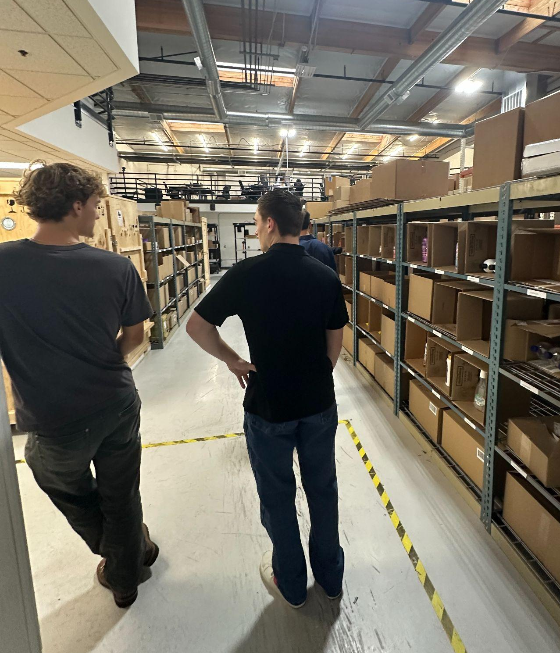
Site Visit
Location: RobustAI Office in San Carlos, CA
Purpose:
Observe basic features & functionalities of CARTER robot
Simulate load & unload process to identify bottlenecks & brainstorm solutions
Findings:
Totes manually lifted & scanned on stationary scanner before loading

Slide 12
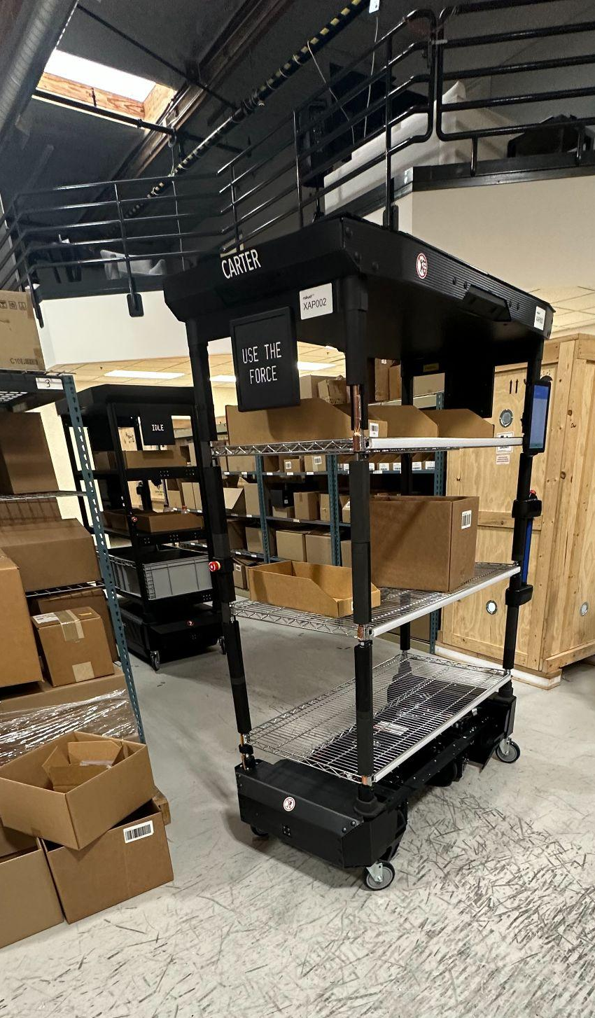
Project Risks
Risk | Mitigation Strategy
CARTER robot is not capable of interaction with our process solution
Solution is not compatible with RobustAI customer sites
Prototype is not reliable / dependable enough for production use | Use proven components, run repeated test cycles, apply modular design for easy fixes

Slide 13
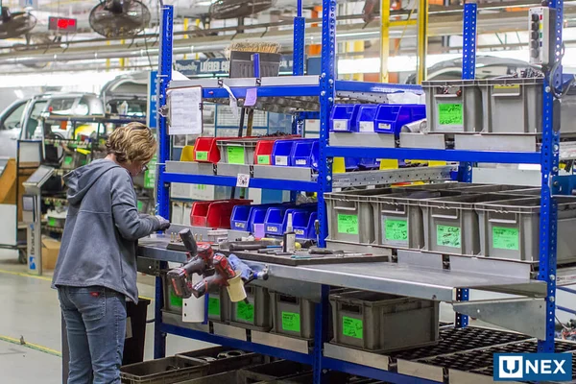
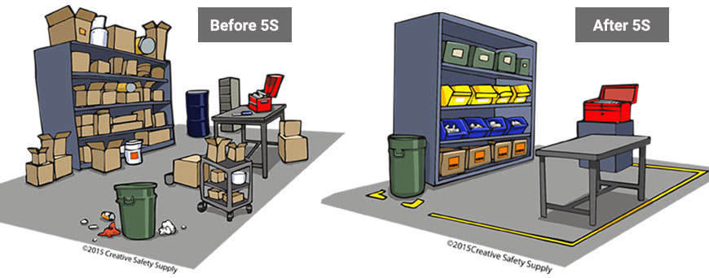
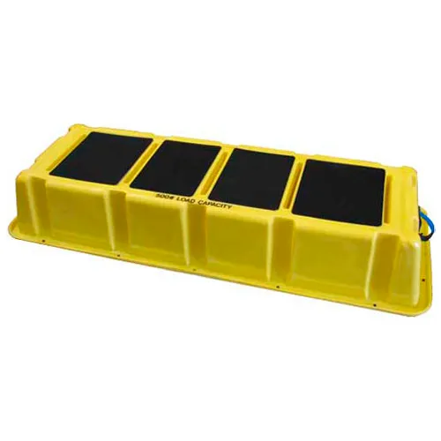
Solution Direction 1: Optimized Manual Workstation
Focuses on streamlining human-robot interaction
UI improvements
Workflow design
Minimizes capital expenditure

Slide 14
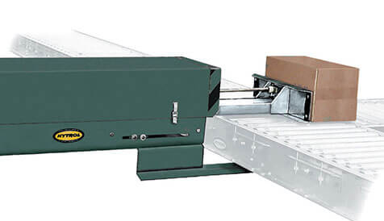
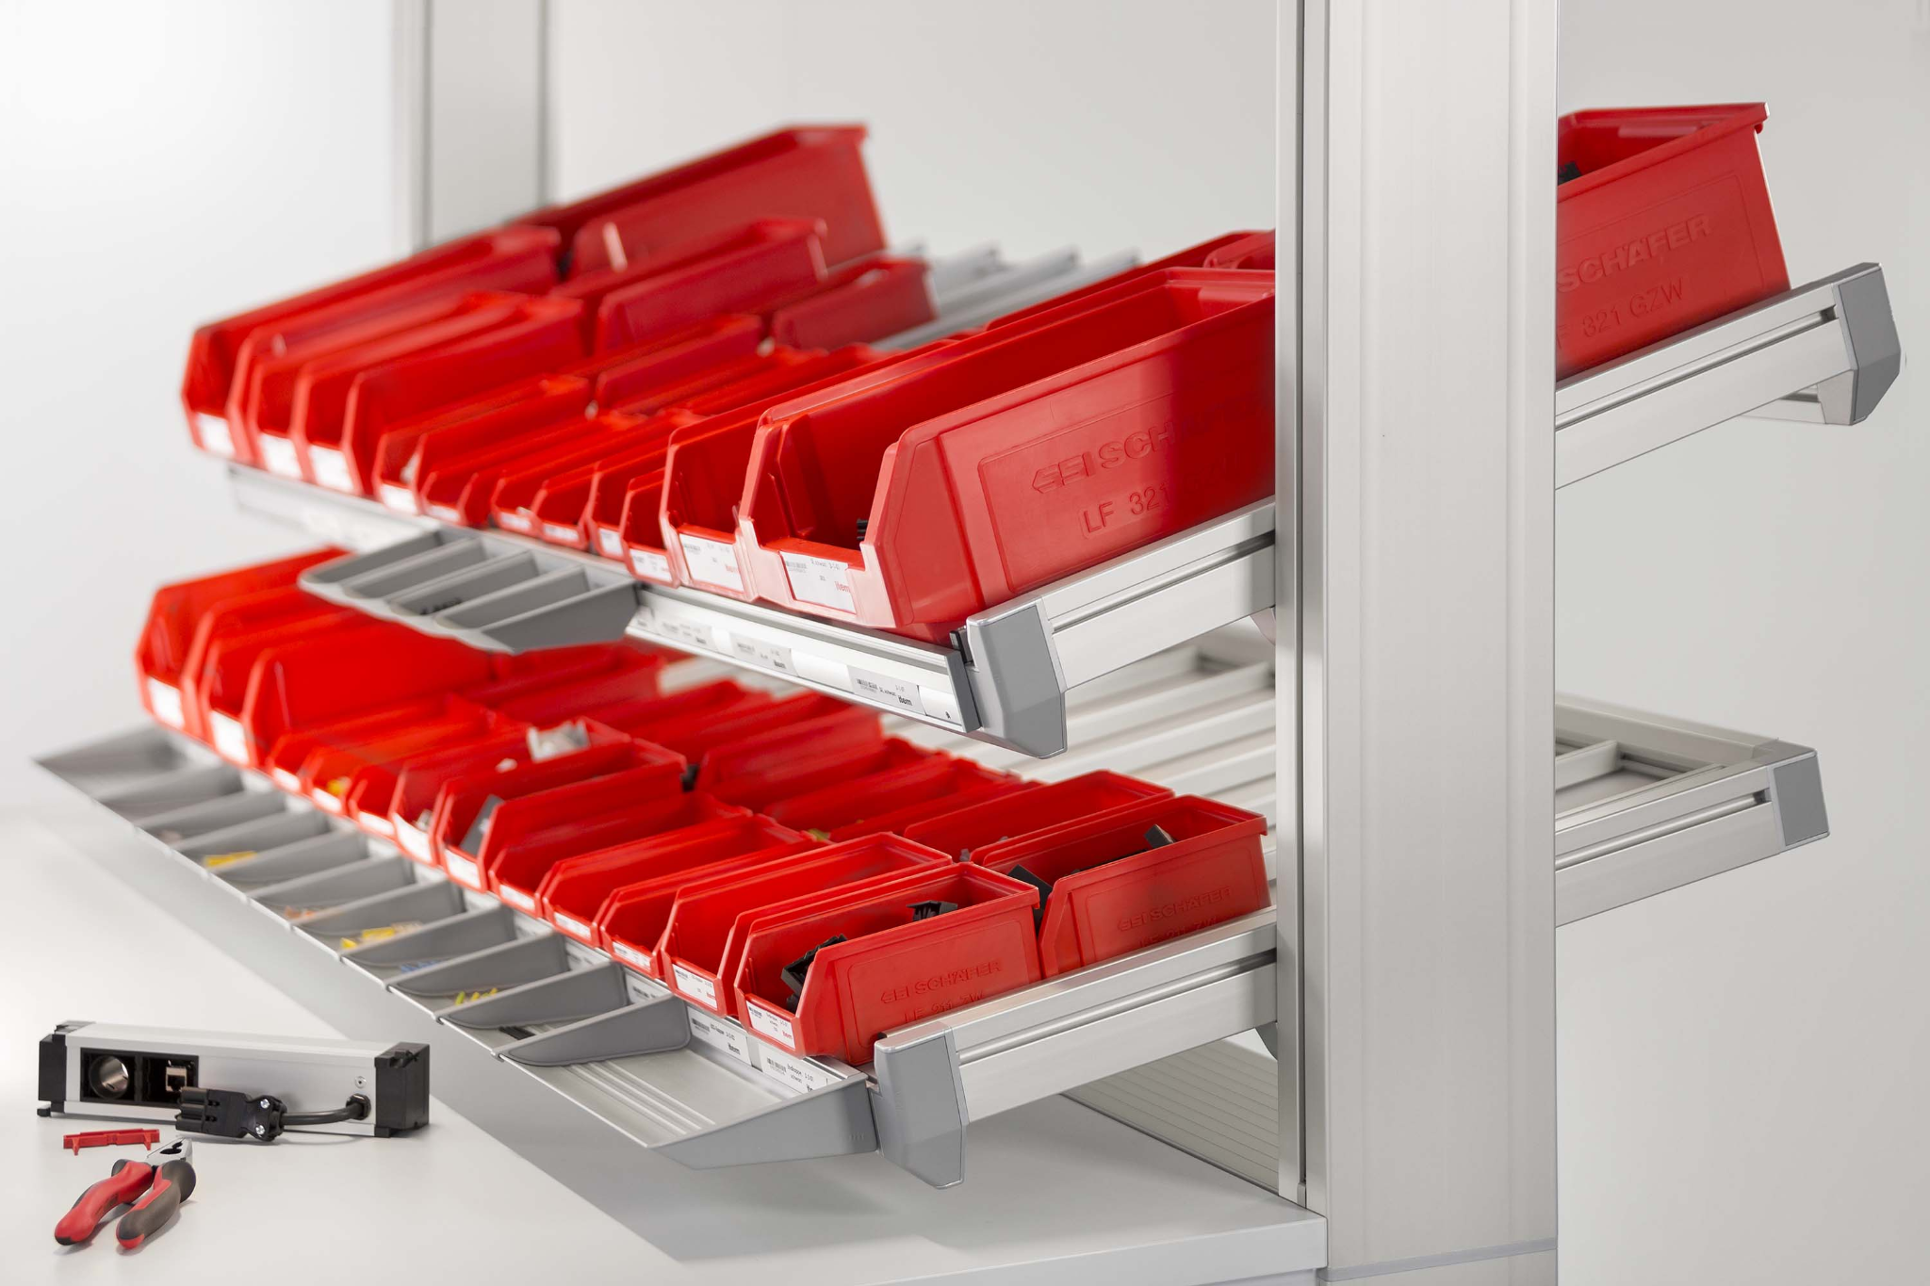
Solution Direction 2: Gravity-Assisted Mechanization
Employs low-cost mechanical infrastructure
Automates the physical lifting and conveying of totes
Reduces the most strenuous manual motions

Slide 15
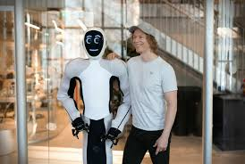
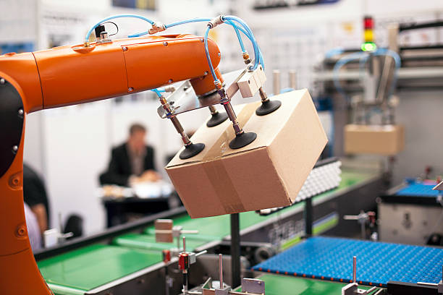
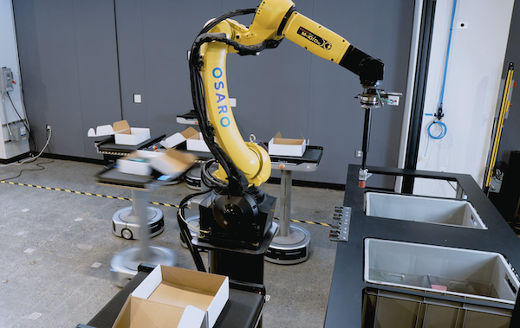
Solution Direction 3: Fully Automated Tote Exchange
A high capital, high speed solution for maximum throughput
Eliminates the human operator
Process is done in one single and minimal time window

Slide 16
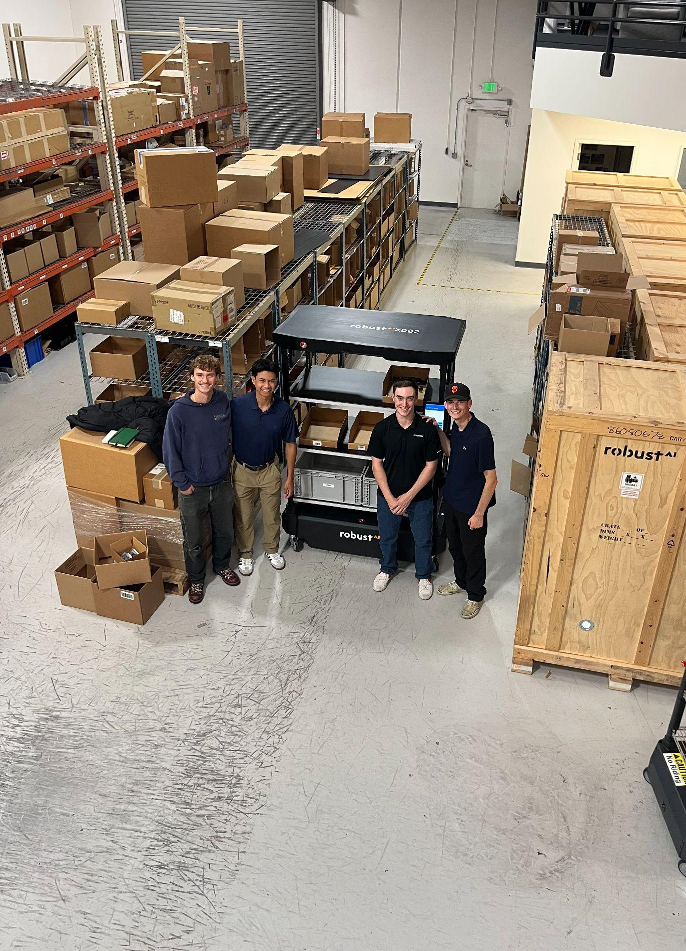
Next Steps
Moving forward, our ROBUSTAI group will consider each solution direction presented, and through our evaluations we will discuss future implementations as well as determining which of the solutions is most impactful, feasible, and meets the target metrics described in our initial project scope.

